Slide 1
The 4th threshold = Seeking: the precondition to enter this threshold: believe that a personal relationship with God is possible It is like ‘Dating with a purpose, but not yet being married’ - Is this person the one? … Should I give my life to this One (Jesus)? P.172

Slide 2
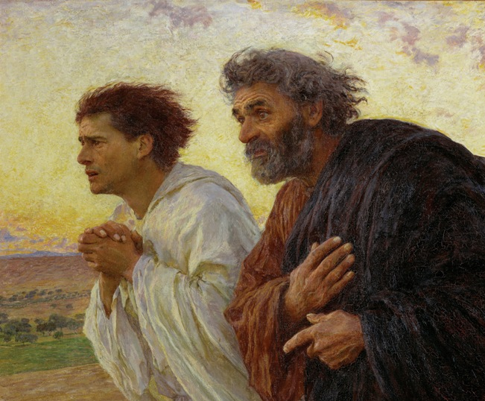
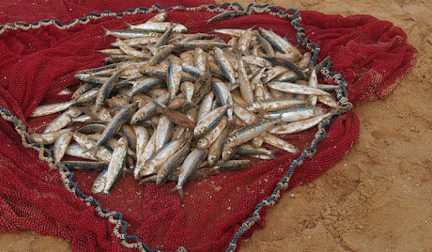
SEEKERS SEEK JESUS and not just God in a general sense or as the “divine,” an impersonal ‘force, or a ‘Higher Power’ Seeking is centred on the possibility of committing oneself to Jesus as a disciple, to drop our nets (things that we do normally) and follow him into the unknown, out of faith and trust. (cf. Luke 14: 25-28).

Slide 3
Following Christ makes demands on our lives; on our priorities, time, money, relationships, and every other aspect of life. In practice: for people on the 4th threshold RCIA is the ideal time, because they ask the questions that Catechesis can answer. P. 173

Slide 4
As seekers progress from threshold to threshold their openness to Jesus should increase. Practical advice: sometimes we need to challenge a person to move from OPENNESS (3rd thr.) to seeking, a. by reminding them of Jn 7: 16-17 b. by inviting them to spiritual and corporal works of mercy (cf. Mt. 25: 31-46) p. 174

Slide 5
c. help seekers to explore the vast diversity of prayers of the Catholic Church (notice which prayers the person likes, ENCOURAGE the practice of those prayers, and do not push the prayers that you like), and also encourage them to attend communal prayer (Mass, Adoration, etc.) and go together to these p.175

Slide 6
d. introduce them to other committed ‘disciples’ (it can be encouraging to hear their stories) e. most of all be an example of a committed ‘disciple’ of Jesus and share your own experiences that might help the seeker f. pray together, and share how the sacraments, Mass, etc. nourished your relationship with Jesus. P. 175-

Slide 7
The Fear of the loss of so called ‘freedom’ Today people only learn from contemporary culture and society what is morally absolutely wrong (do not kill, do not steal, etc.). However they do not feel guilt as much as they feel shame for not achieving what they are called to accomplish. P.176

Slide 8
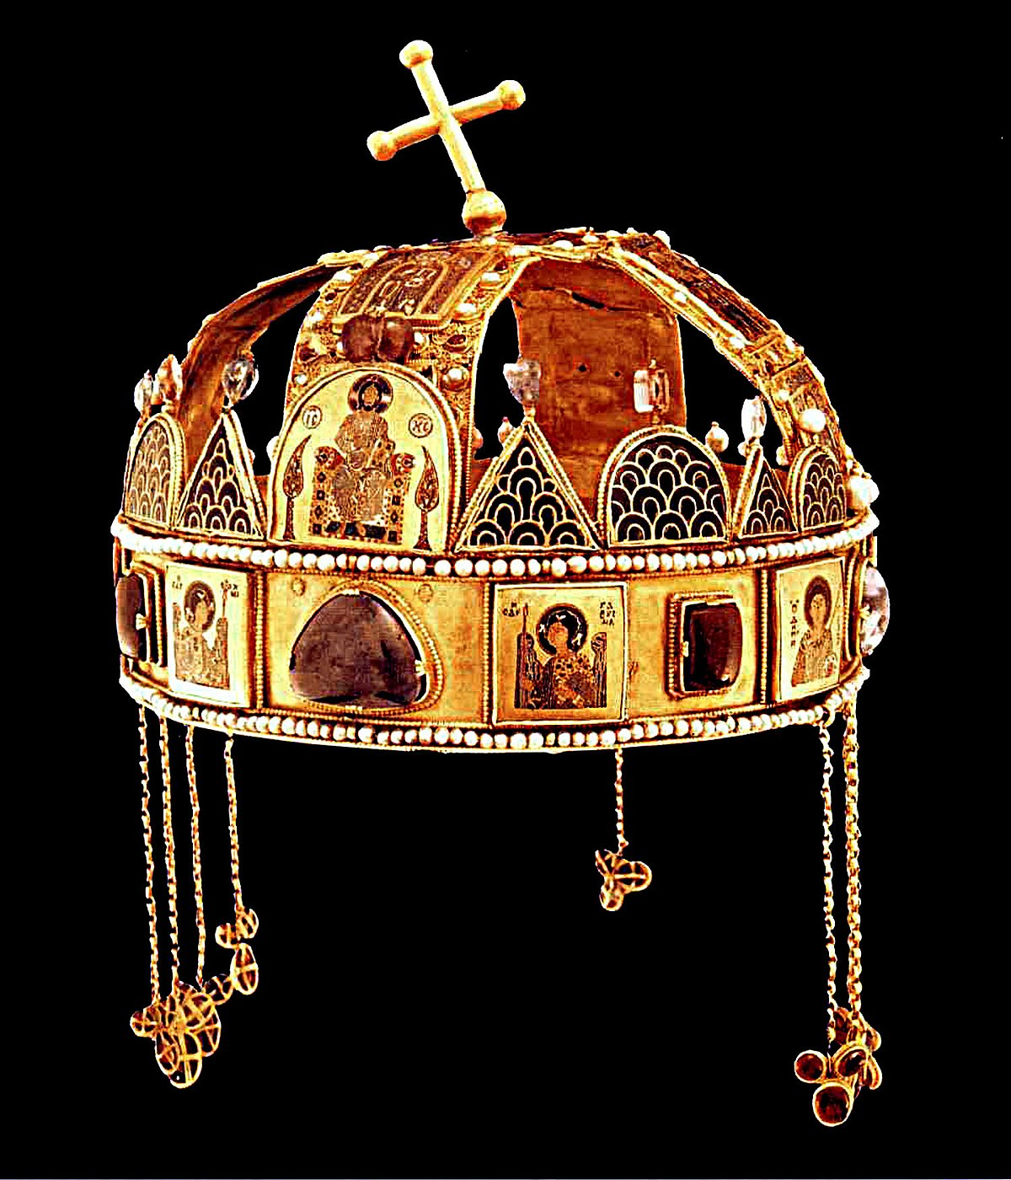
Practical advice: a. in conversations help seekers focus on Jesus and the Kingdom of God, because interestingly it can lead people to a sense of personal sin. b. help seekers realise in what ways the church stands up for social justice, love, peace and holiness, because… p.177
This Photo by Unknown Author is licensed under CC BY-SA

Slide 9
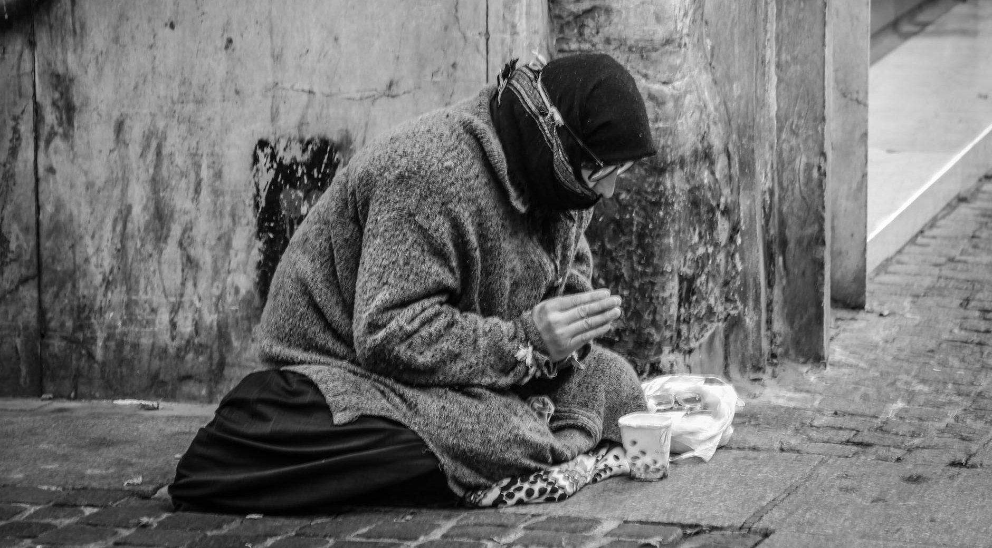
most people are naturally sensitive to issues such as poverty, racism, etc. which are caused by systemic sins. Thus seekers will soon realise also that systemic sin is caused by personal sin of individuals who are part of a system, organisation, etc. p.177

Slide 10
c. You can also help a seeker understand that the Catholic Church honours freedom, but also teaches that freedom is ordered towards true love and virtue, and its misuse will hit back. d. finally help seekers see what they can offer you and others; don’t forget that they are companions on your faith journey, and after all you haven’t arrived either to the end of it… p.177

Slide 11
…you can also learn from them Intentional discipleship At one point seekers also have to commit themselves completely to following Jesus in a committed way. You can be a seeker endlessly! What is the sign of arriving at that point? P. 177-178

Slide 12
It is the point where the seeker feels he/she can’t not commit himself/herself completely to following Jesus. ‘Did not our hearts burn within us…’ (Lk 24:32) It is the moment when you feel you can just sell everything to buy the Pearl of great price (cf. Mt 13:45-46) This is a deliberate act of the will. P.178
This Photo by Unknown Author is licensed under CC BY-SA

Slide 13
Practical advice: a. ask the seeker, when you feel s/he is ready, if s/he is ready to make a commitment to follow Jesus with his/her whole heart, mind and soul and strength. You are acting here in the name of Christ, as if the bridegroom is asking the bride if she is willing to marry him. P.179
This Photo by Unknown Author is licensed under CC BY-NC

Slide 14
What if the person says ‘NO’? Ask respectfully ‘Why not?’ In other words find out what are the blocks there? Then help the person address those blocks, or help him/her put aside those blocks. Some seekers may just want to review their journey up to this point. P.179

Slide 15
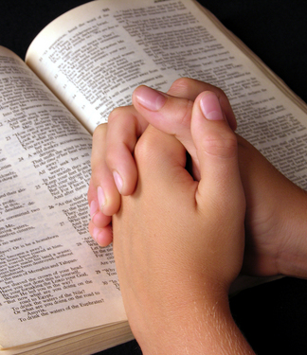
Be prepared that spiritual warfare becomes very intense at the verge of intentional discipleship. Practical advice: pray for those on the verge of decision making (see story of Jenn which demonstrates opposition when someone comes to a decision point) p.180
This Photo by Unknown Author is licensed under CC BY-NC-ND

